Slide 1
Hacking

Slide 2
content
History
What is hacking?
Hacker
Types of hacker
Who do hackers hack
Types of hacking
Types of hacking programme
Some biggest hacks in history
conclusion

Slide 3
history
First computer hack was in 1960s
People started hacking computer in 1980s
Laws were made in 1990s

Slide 4
What is hacking?
Hacking refers to activities that seek to compromise digital devices and networks through unauthorized access to an account or computer system. Hacking is not always malicious act but it is most commonly associated with illegal activities.

Slide 5
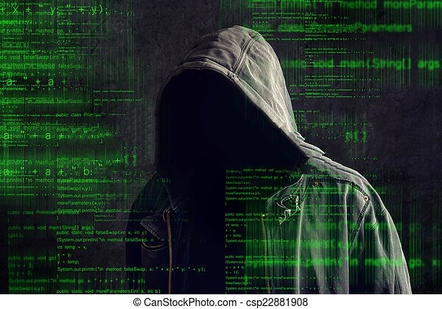
hacker
A hacker is someone who finds methods for breaching defenses and exploiting weakness in computer system or network

Slide 6
Types of hacker
Hackers are of seven types:
white hat hacker
gray hat hacker
black hat hacker

Slide 7
Why do hackers hack
Steal information
For fun
Money
Political motives

Slide 8
Types of hacking
Website hacking
Network hacking
Ethical hacking
Email hacking
Password hacking
Online banking hacking
Computer hacking

Slide 9
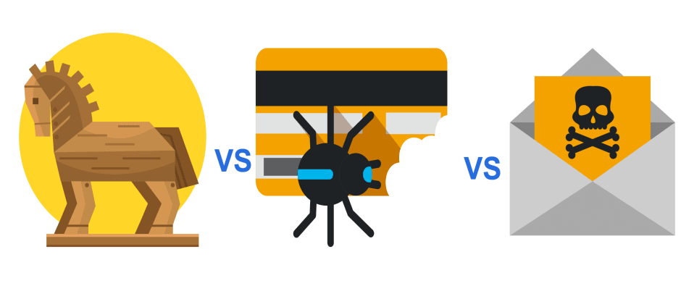

Types of hacking programme
Trojan horses
Computer virus
Computer worms

Slide 10
Some biggest hacks in history
The Citibank hack (1995)
The Melissa virus (1999)
The mafiaboy attacks (2000)

Slide 11
conclusion

